Slide 1
言行橘子
第十組

Slide 2







Slide 3
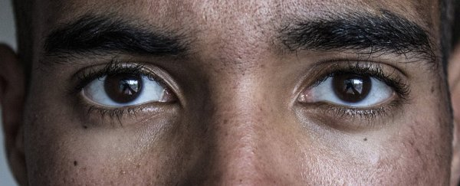
眼神的重要

Slide 4

互相的眼神交流能增進感情
Kellerman, J., Lewis, J., & Laird, J. D. (1989). Looking and loving: The effects of mutual gaze on feelings of romantic love. Journal of research in personality, 23(2), 145-161.

Slide 5
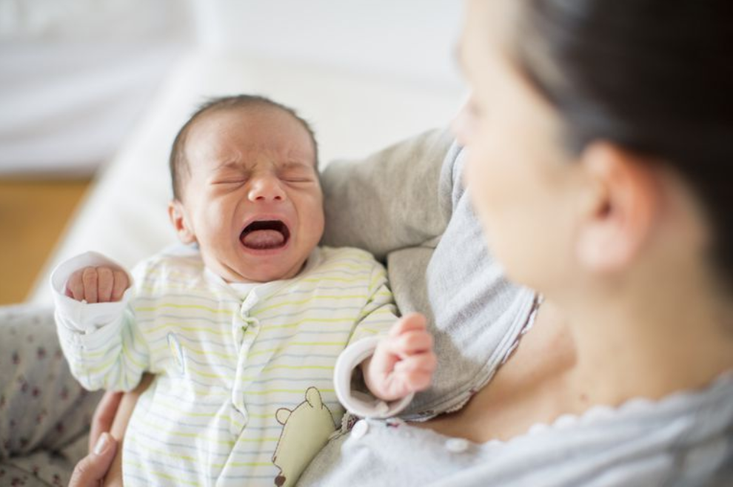
越多眼神接觸讓嬰兒越少哭泣
Lohaus, A., Keller, H., & Voelker, S. (2001). Relationships between eye contact, maternal sensitivity, and infant crying. International Journal of Behavioral Development, 25(6), 542-548.

Slide 6

眼神交流增進課堂管理
Jasminka Kochoska, Biljana Gramatkovski (2016). EYE CONTACT AS THE MOST POWERFUL WAY FOR CLASSROOM MANAGEMENT.

Slide 7

跟狗對到眼增加被追咬的機會
Jarrod Booker. (2007, Aug 10). 'Eye contact' likely cause for dog attacks. Retrieved from https://www.nzherald.co.nz/nz/news/article.cfm?c_id=1&objectid=10457124

Slide 8
眼神的重要

Slide 9
眼球運用情境模擬器
各種情境
提早訓練
任何可能發的事
自行定義
熟能生巧
遇上時從容應對

Slide 10


